Slide 1

Project 2: Coronavirus, why won’t you wear a mask?!
Bhavna, Maclean, Calvin

Slide 2

Reason for Choosing covid-19
Most current topic that is effecting everyone worldwide
A lot of different statistics that are out there, wanted to see data for ourselves
Big set of data that is widely accessible

Slide 3
Sources of Data
Worldometers coronavirus site
https://www.worldometers.info/coronavirus/country/us/
Facts about coronavirus from cdc
https://www.cdc.gov/coronavirus/2019-nCoV/index.html
Donation page from redcross
https://www.redcross.org/donate/disaster-donations.html

Slide 4
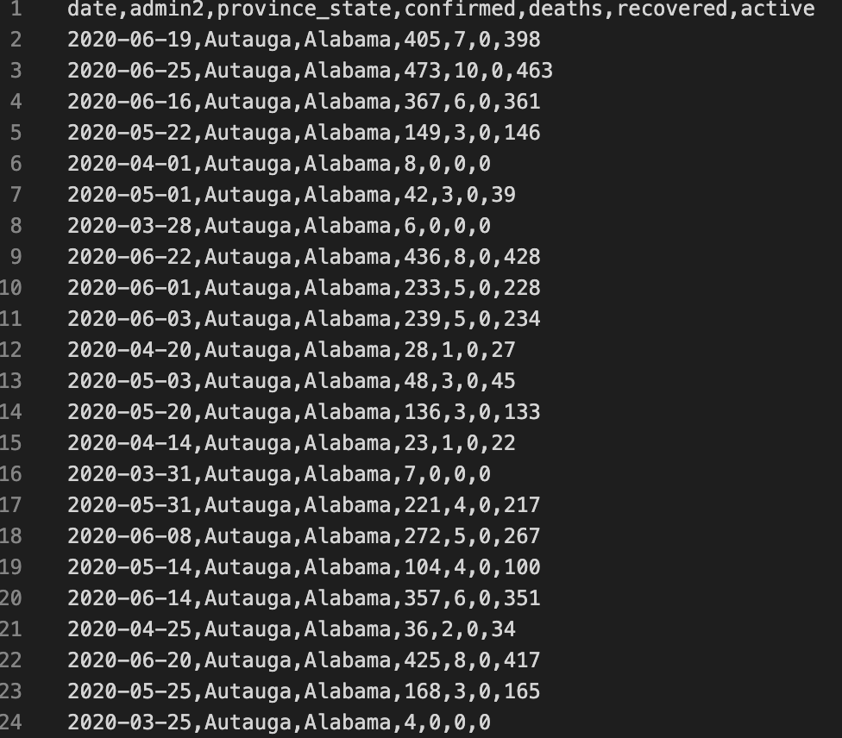
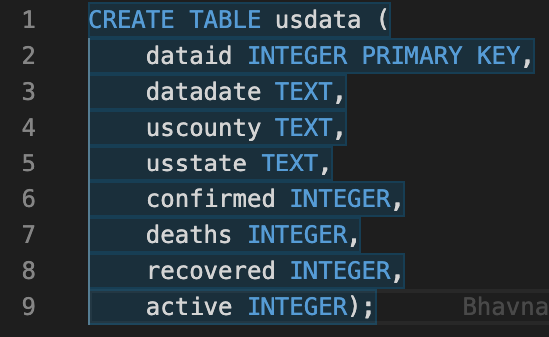
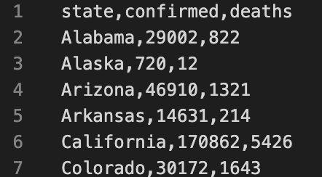
Data Manipulated

Slide 5
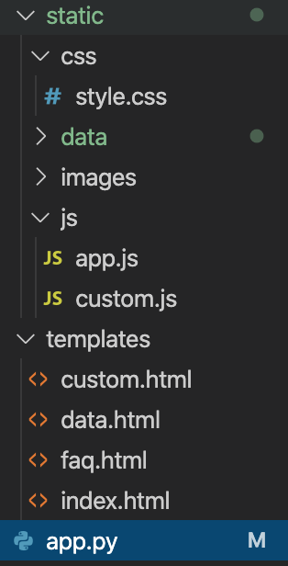
Overview
CSS for style of webpage
App.js for our d3 graph
Custom.js for our plotly graph
Custom.html
Data.html for data webpage
Faq.html for our faqs webpage
Index.html
App.py

Slide 6
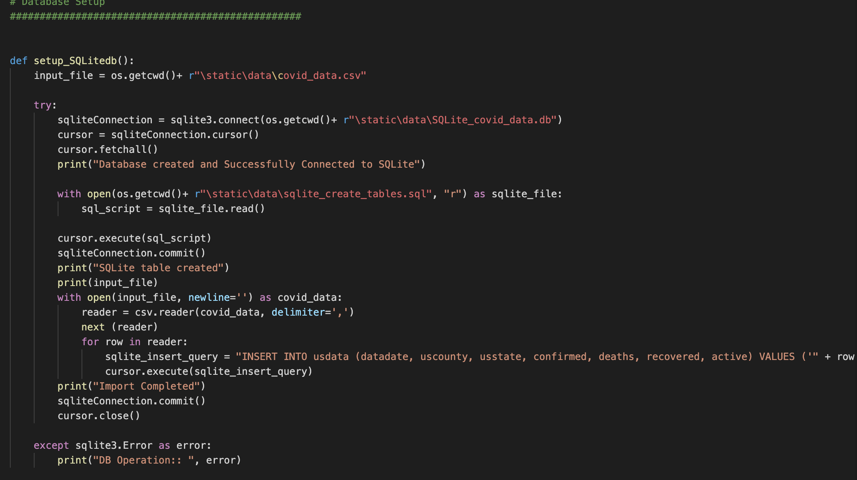
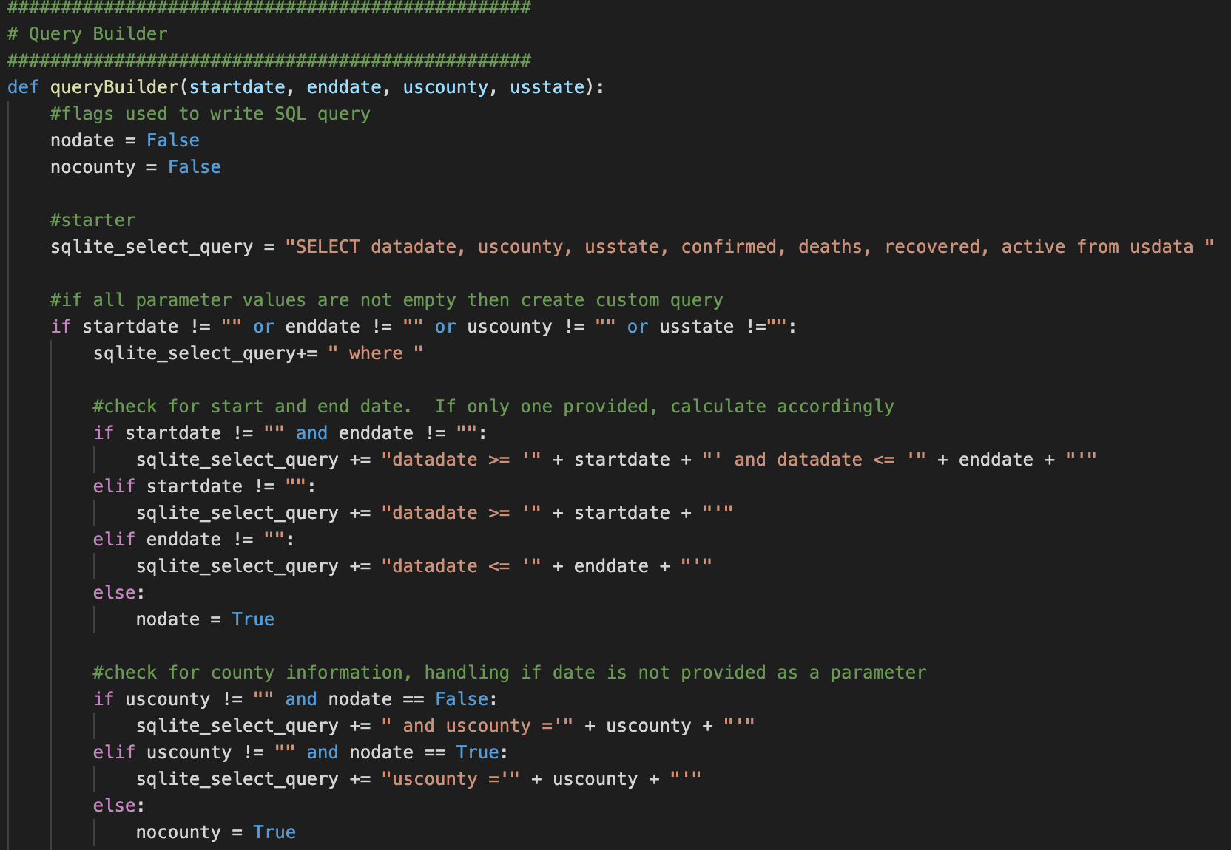
Tools that were used in app.py
Sqlite for database

Slide 7
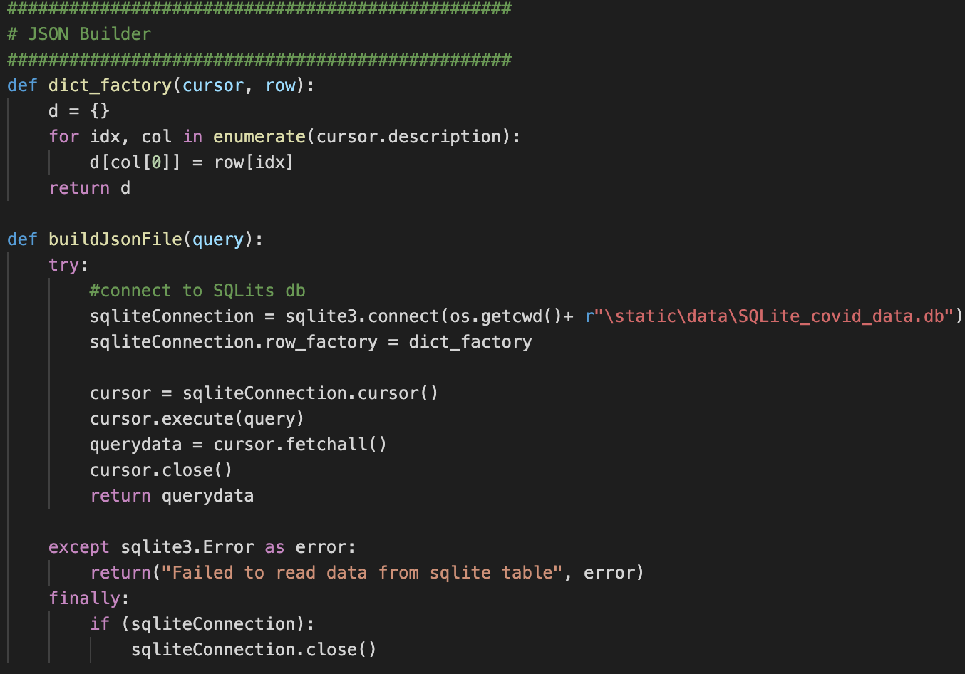
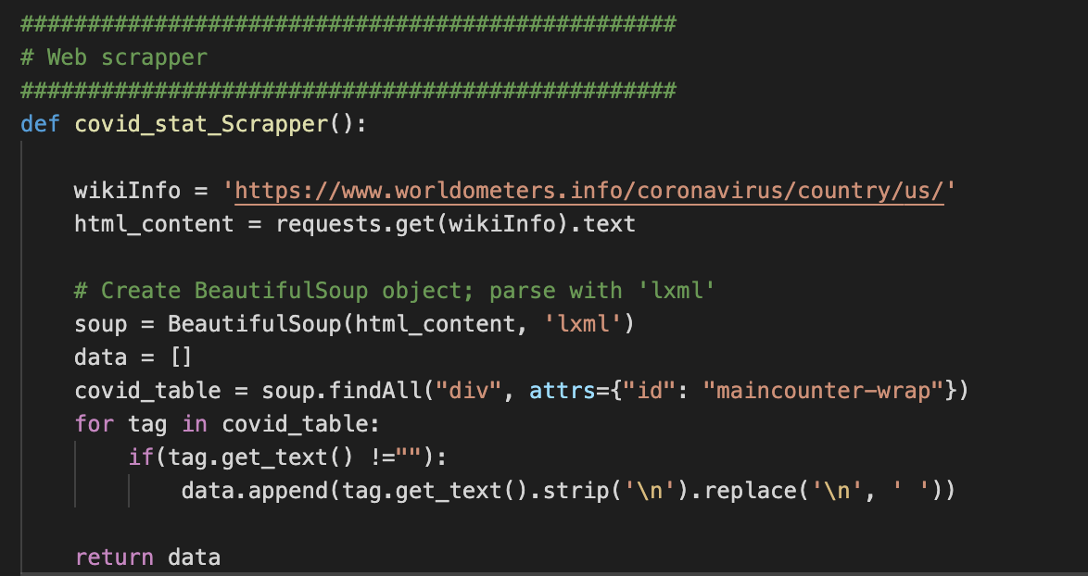
Tools Continued..
Json to connect to the sqlite database
Beautiful soup for webscrapping

Slide 8
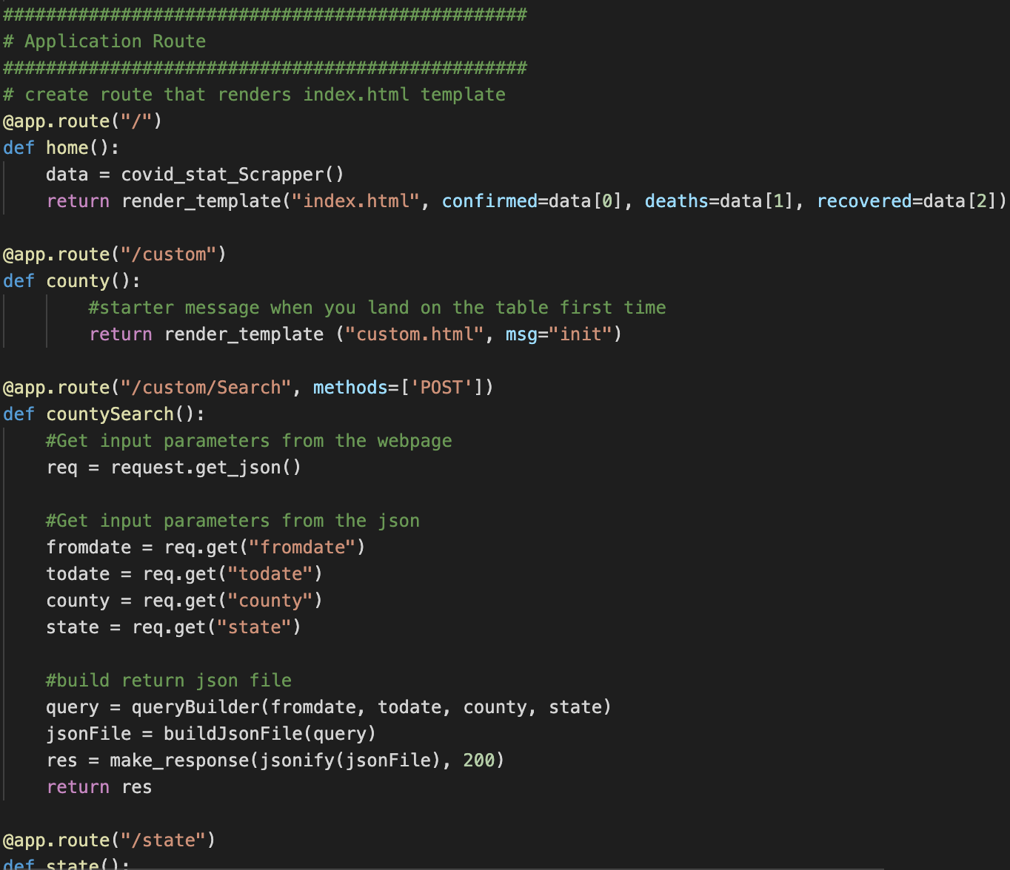
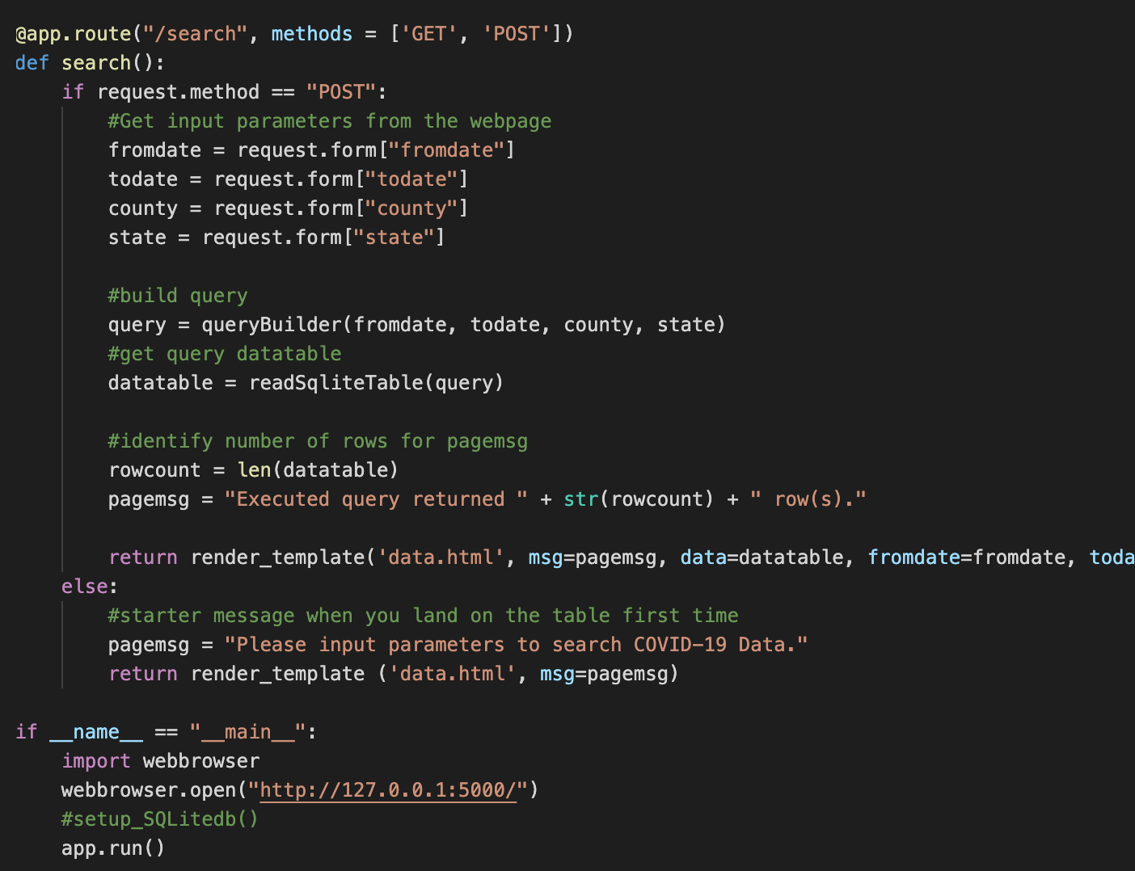
Application route
Created a route for the application route
input parameters from the json
Built the return json file
got input parameters from the webpage
Built and got the query datatable
Identified rows for pagemsg
Created starter message when you land on table

Slide 9
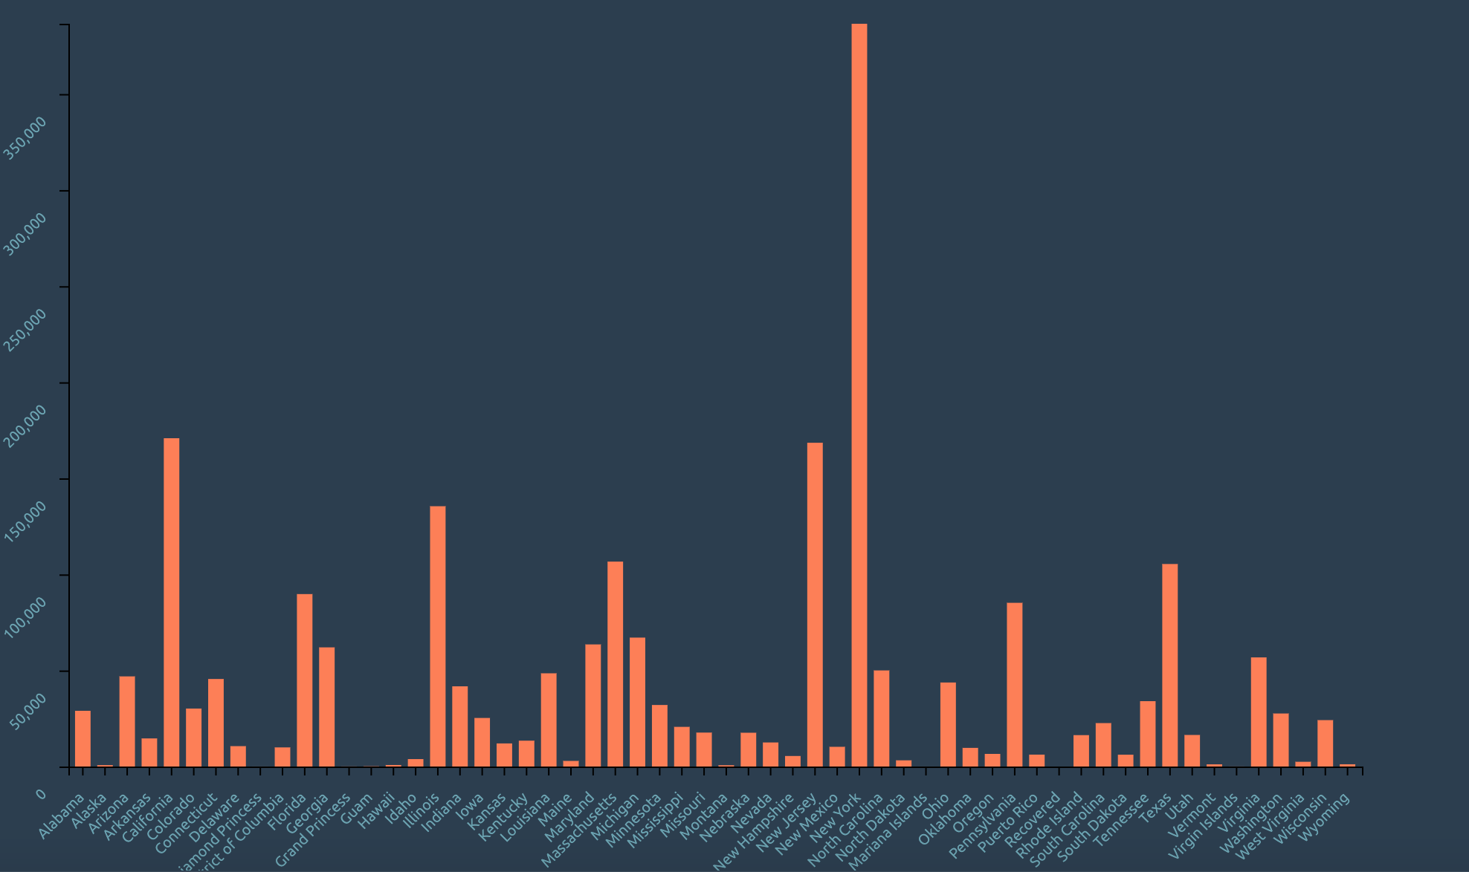
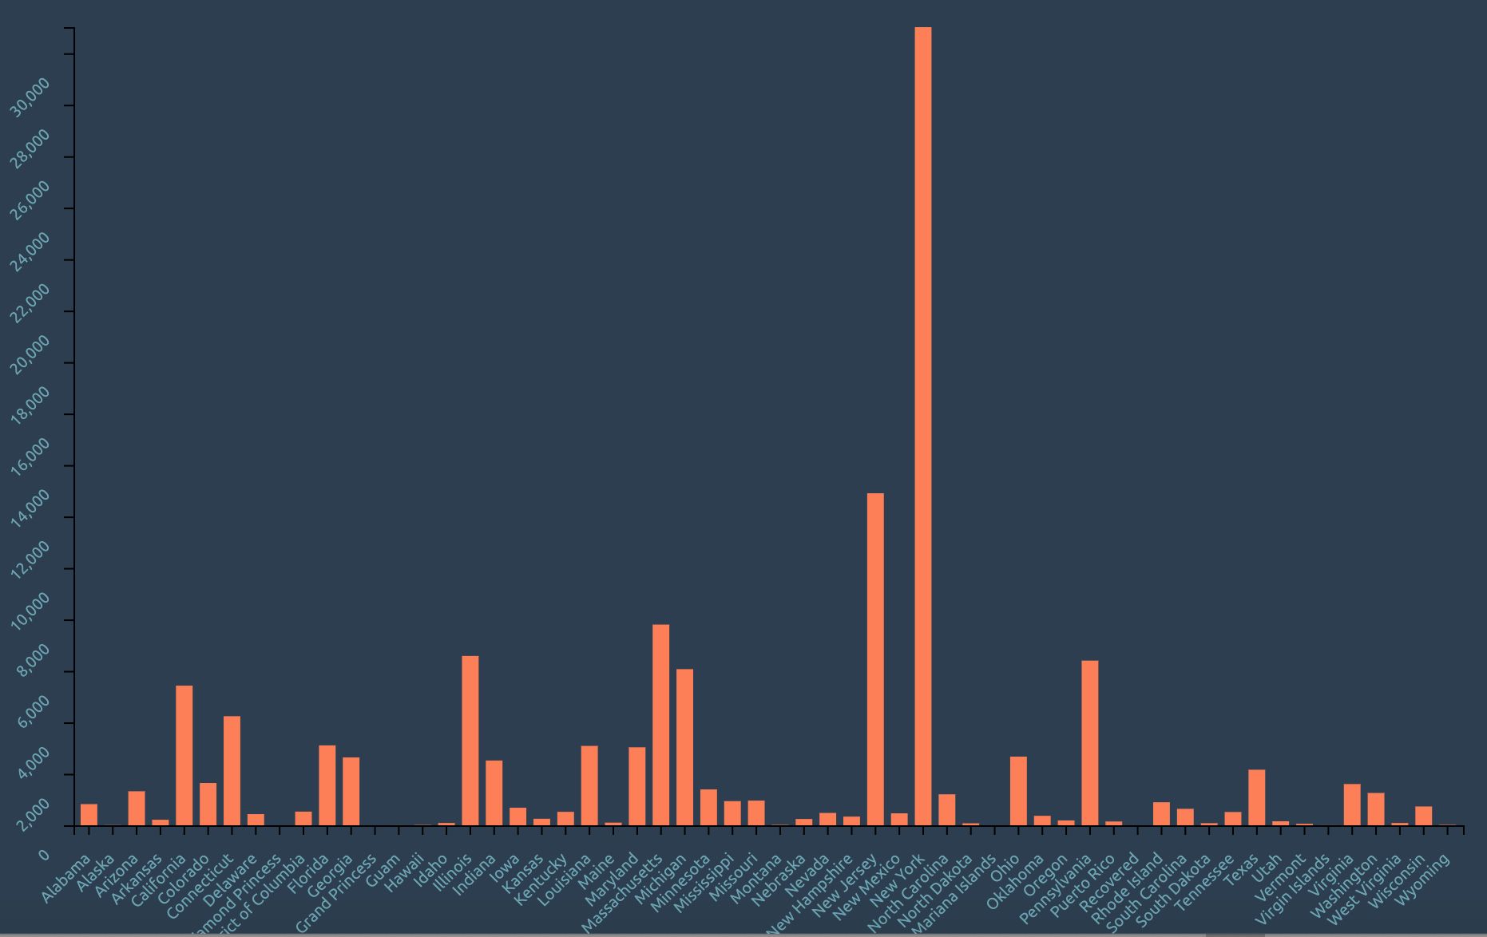
Confirmed cases and deaths graphs and trends noticed
States with higher populations and big cities like New York, NJ, Illinois, and California have had the highest confirmed cases
Confirmed deaths seem to follow the same trend, except NY has been hit the hardest showing from the data.

